Slide 1
COMPUTER VISION
Lecture 2 (06/08/2026)
0714 02 CSE 4239

Slide 2
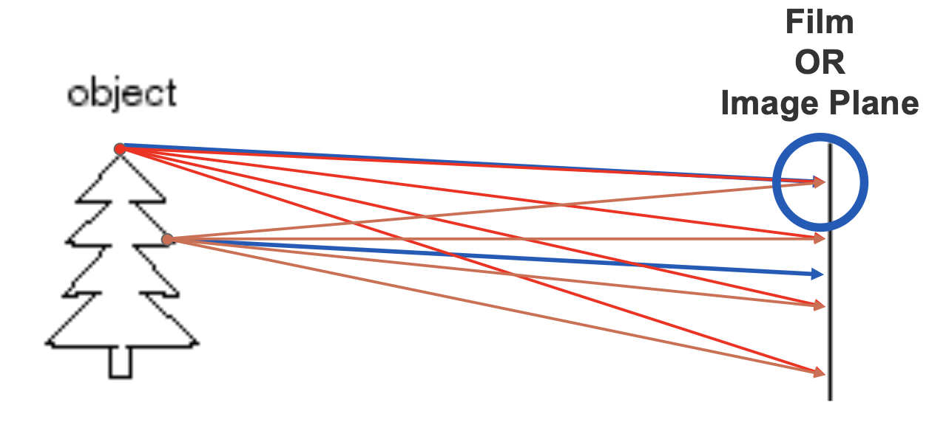
Let’s design a camera
Idea 1: put a piece of film in front of an object
Do we get a reasonable image?

Slide 3
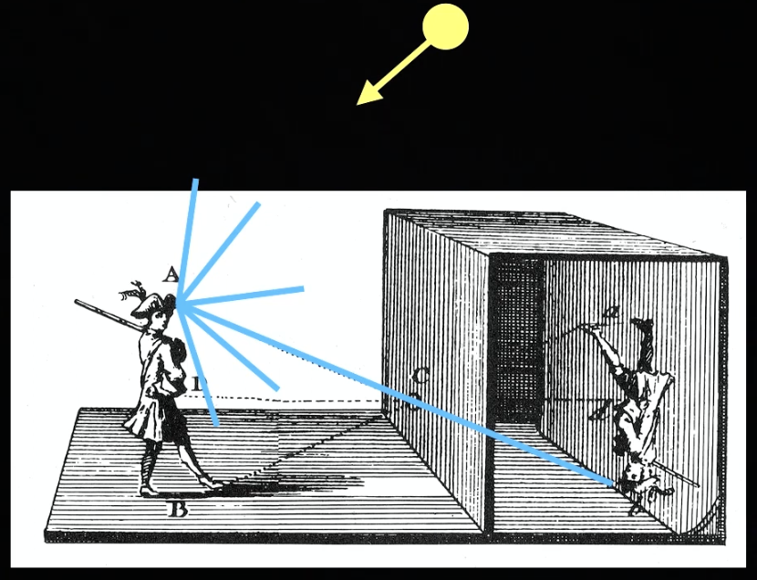
Pinhole camera model
If light passes through a hole into a dark room, an inverted image of the scene is projected onto the wall.
• Pinhole model:
– Captures pencil of rays– all rays through a single point (pinhole)

Slide 4
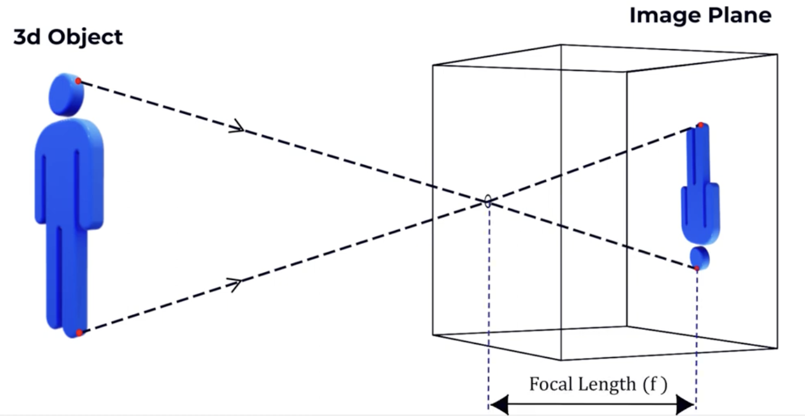
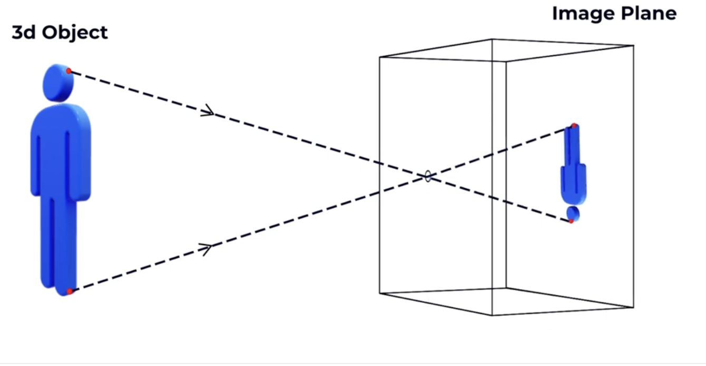
Pinhole camera model
What if we bring forward the image plane towards the hole?

Slide 5
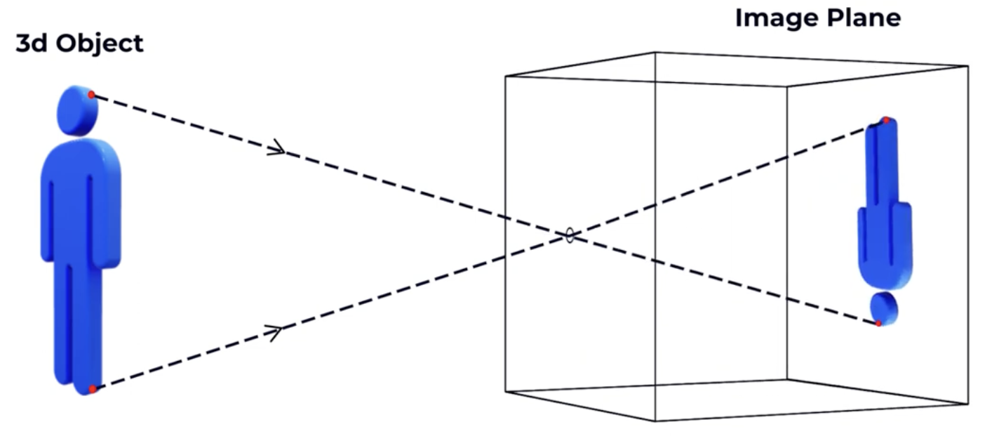
Pinhole camera model
What if we move the image plane farther form the pinhole?

Slide 6
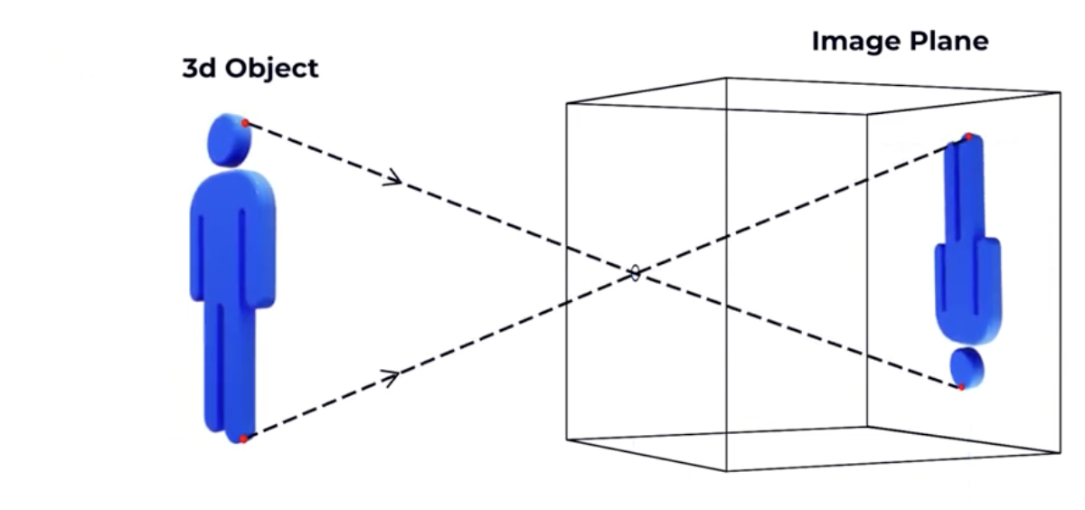
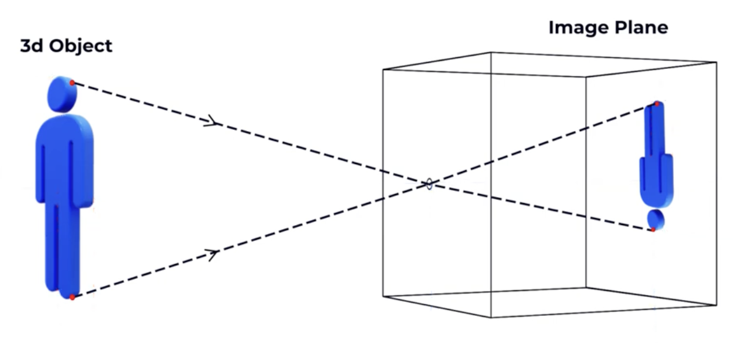
Pinhole camera model
What if we move the object closer to the pinhole?

Slide 7

Pinhole camera model
These two observations can be expressed as:
  $image height∝f$
  $image height∝\frac{1}{dist to the object }$

Slide 8
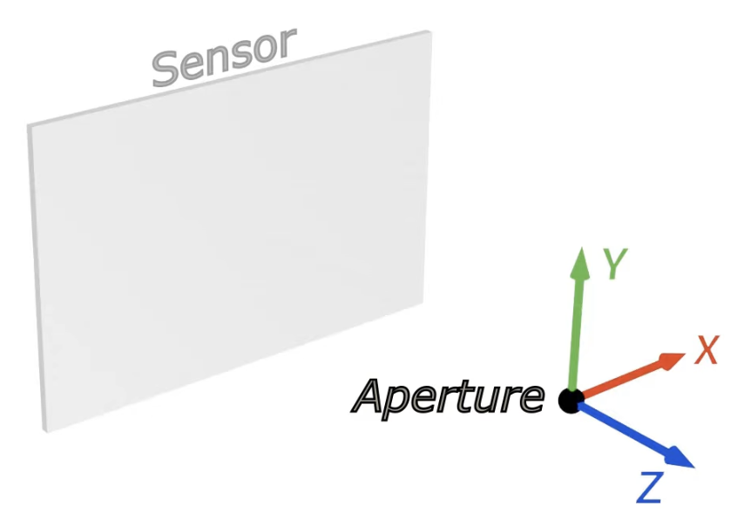
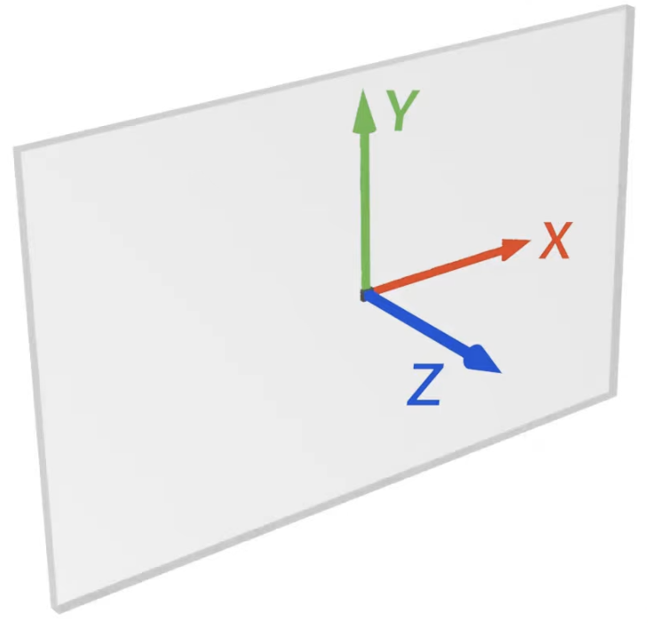
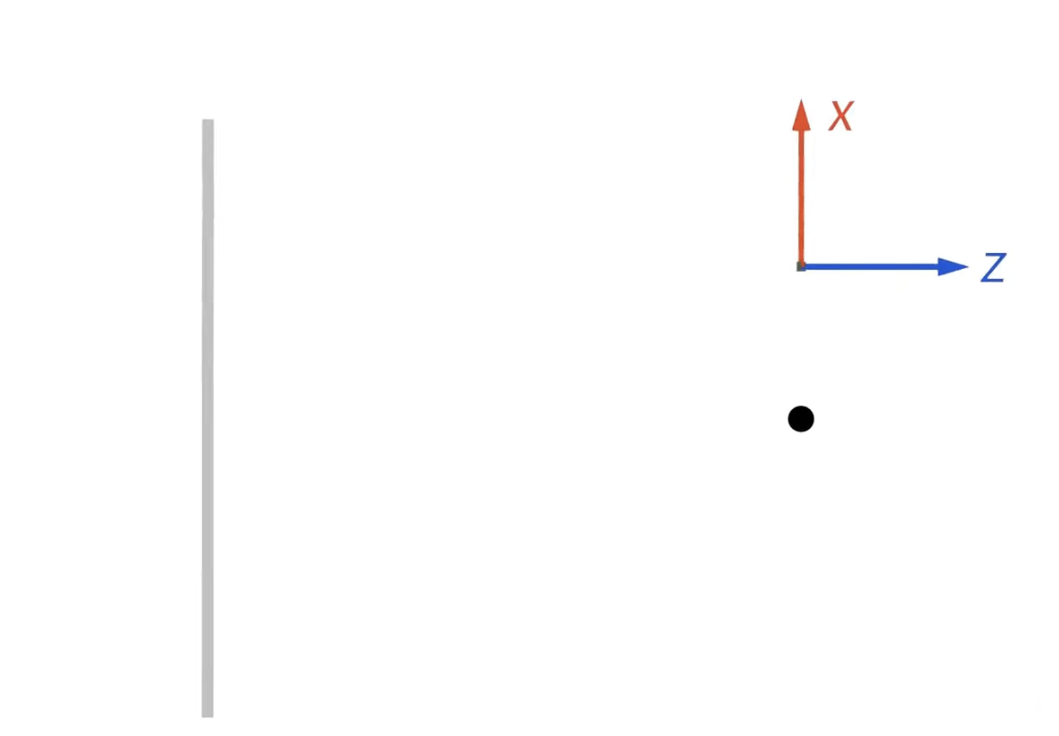
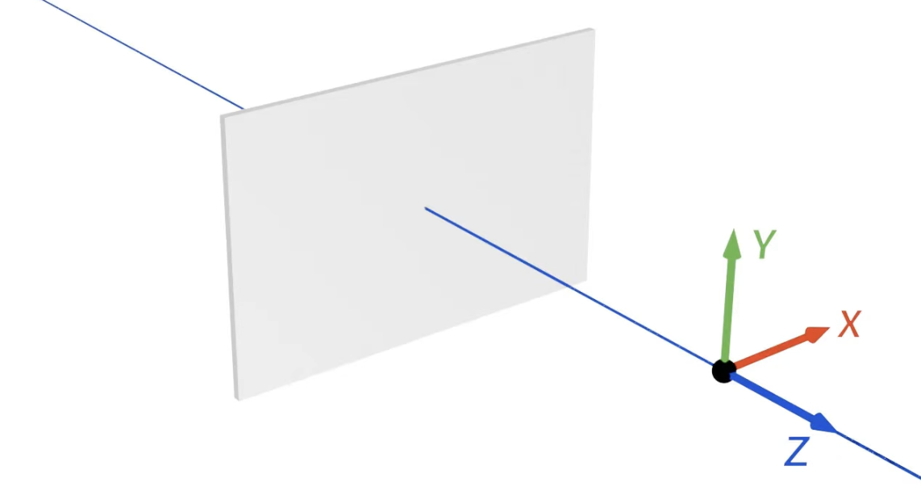
Co-ordinate system
3d World

Slide 9
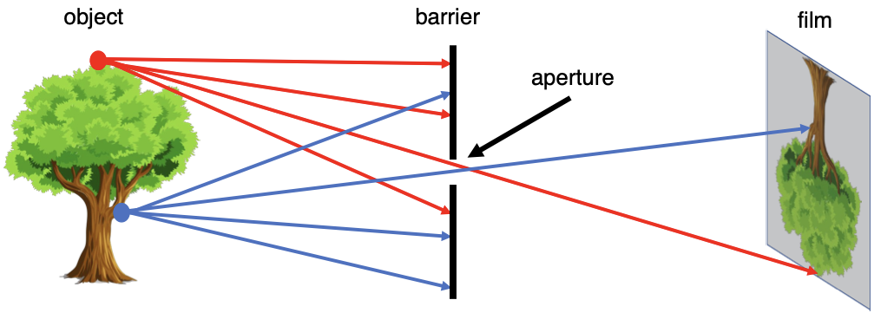
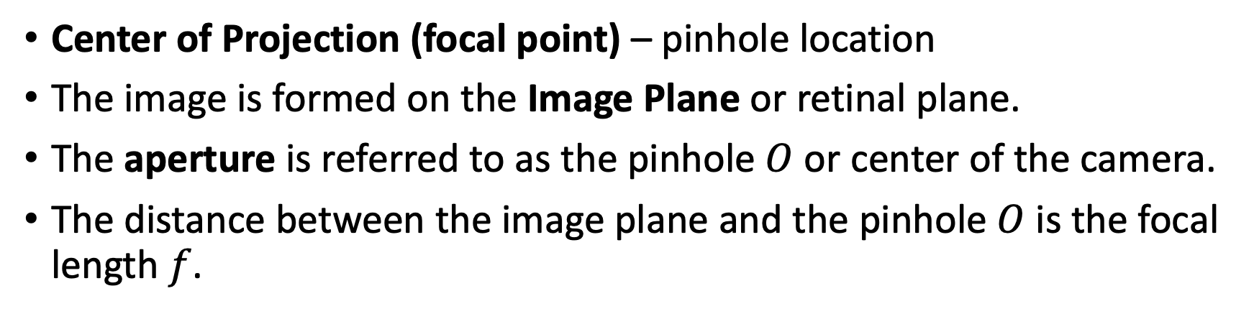

Pinhole camera model
Center of Projection (focal point) – pinhole location
The image is formed on the Image Plane or retinal plane.
The aperture is referred to as the pinhole $O$ or center of the camera.
The distance between the image plane and the pinhole $O$ is the focal length $f$.
O
$$f$$
Image plane

Slide 10
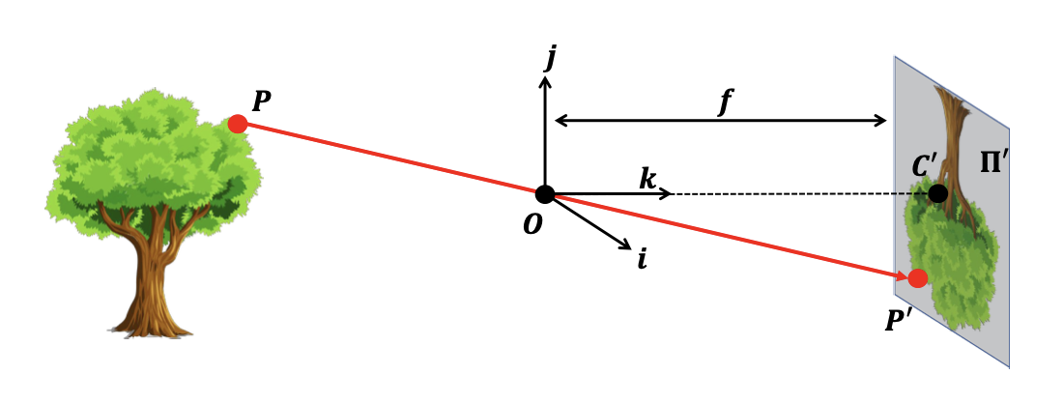



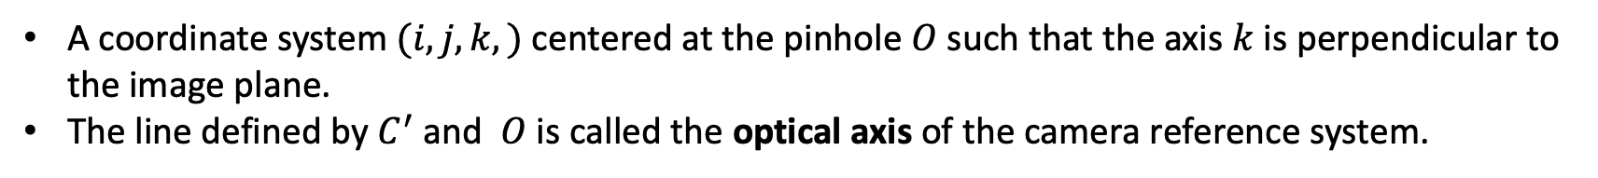

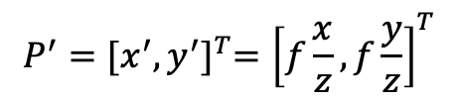
Camera reference system
A coordinate system $(i, j, k,)$ centered at the pinhole $O$such that the axis $k$ is perpendicular to the image plane.
The line defined by $C^{′}$ and $O$ is called the optical axis of the camera reference system.
$P$ will be projected onto the image plane $Π′$.
The pinhole is projected onto $Π′$ at a new point $C′$
$$P={\left[\begin{matrix}x & y & z\end{matrix}\right]}^{T}$$
P′C′O is similar to the triangle formed by
P, O and (0,0,z).
Using the law of similar triangles:
$$P^{′}={[x^{′},y^{′}]}^{T}={\left[f\frac{x}{z},f\frac{y}{z}\right]}^{T}$$
$$0, 0, z$$
$$P′={\left[\begin{matrix}x^{′} & y^{′}\end{matrix}\right]}^{T}$$

Slide 11
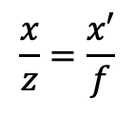






Flatten coordinates
Why do we need to define the coordinate systems?
$$\frac{x}{z}=\frac{x′}{f}$$
$$x^{′}=f\frac{x}{z}$$
Image coordinate
system
$$x$$
$$f$$
Optical axis
$$z$$
$$O$$
World coordinate
system
$$x′$$
Notes:
- this is the so-called perspective projection equation
- we're going to see is that even though we're working with a very simple camera reference system here even modern camera still exhibit this basic perspective projection equation.
- Let’s see a quick demo.

Slide 12
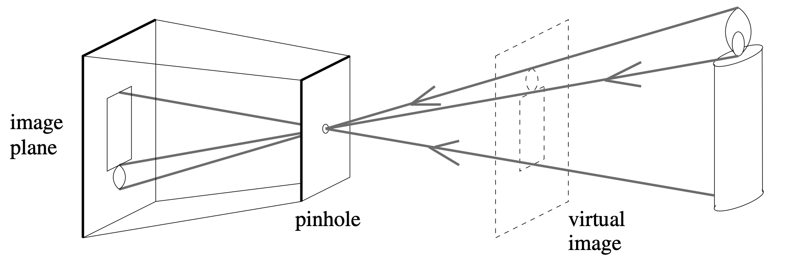
Virtual image plane
Perspective projection creates inverted images.
We may avoid the inversion by considering a virtual image associated with a plane (virtual image plane) lying in front of the pinhole.
Virtual image plane is at the same distance from it as the actual image plane.
Notes:
This virtual image is not inverted and strictly equivalent to the actual one.

Slide 13
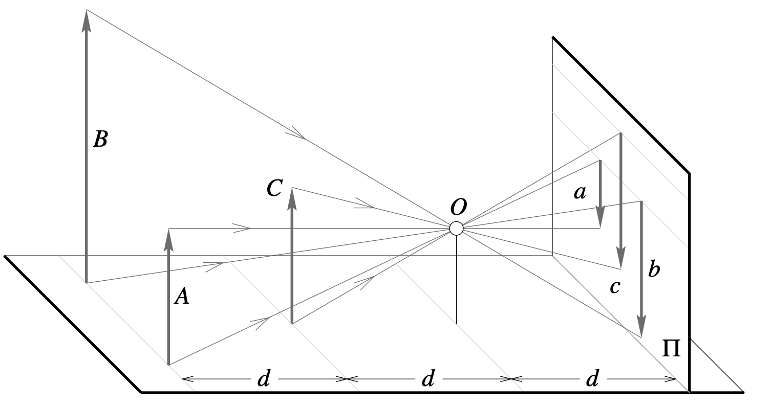
Eﬀect of perspective projection
Notes:
far objects appear smaller than close ones: The
distance d from the pinhole O to the plane containing C is half the distance from O to the
plane containing A and B;
the images b and c xof the posts B and C have the same height, but A and C are really half the size of B

Slide 14
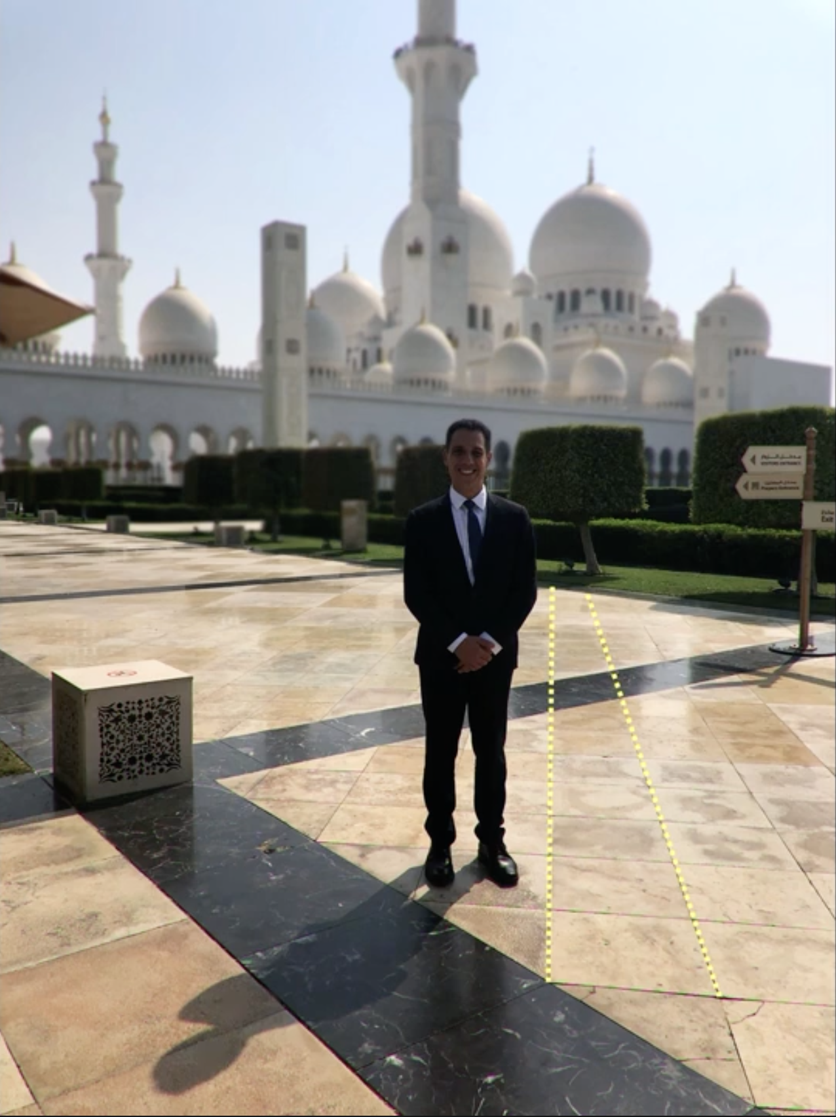
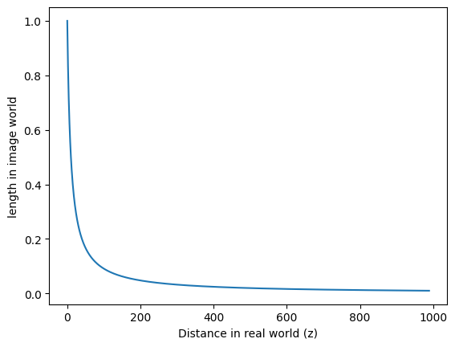
Perspective projection

Slide 15
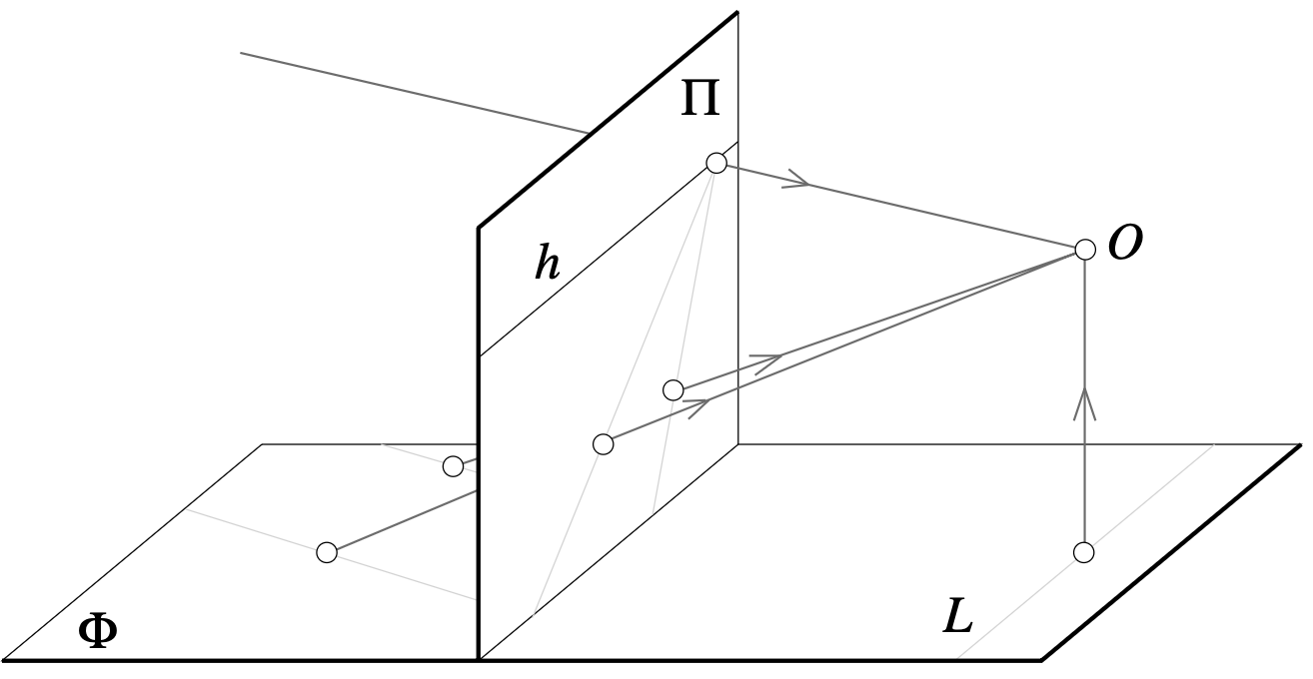
Eﬀect of perspective projection
Notes:
the images of parallel lines intersect at the horizon.
another well-known eﬀect: the projections of two parallel lines lying in some plane Φ appear to converge on a horizon line h formed by the intersection of the image
plane Π with the plane parallel to Φ and passing through the pinhole.
Note that the line L parallel to Π in Φ has no image at all.
Note that the image plane Π is behind the pinhole in (a) (physical retina), and in front of it in (b) (virtual image plane). Most of
the diagrams in this chapter and in the rest of this book will feature the physical image plane, but a virtual one will also be used when appropriate, as in (b).

Slide 16
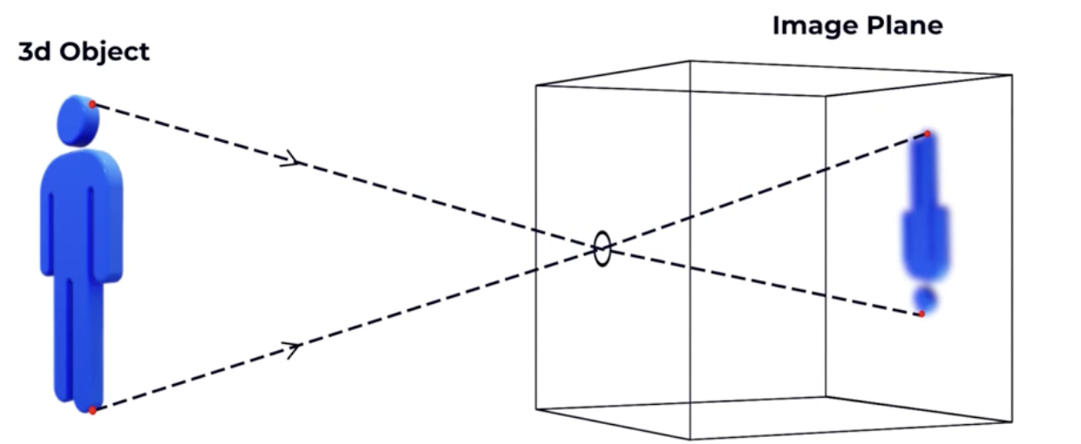
What if we increase the pinhole size?
Notes:
As the aperture size increases, the number of light rays that passes through the barrier consequently increases.
With more light rays passing through, then each point on the film may be aﬀected by light rays from multiple points in 3D space, blurring the image.

Slide 17
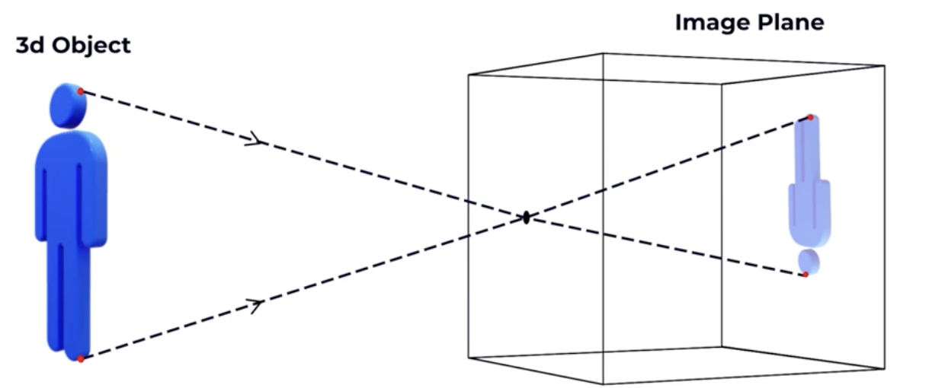
Can we get a sharper image if we decrease the pinhole size?
Notes:
Although we may be inclined to try to make the aperture as small as possible, recall that a smaller aperture size causes less light rays to pass through, resulting in crisper but
darker images.

Slide 18
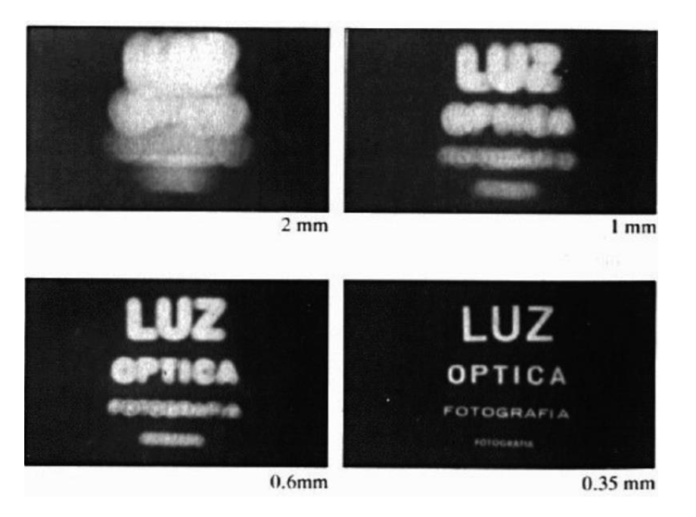
Aperture in pinhole model
Assumption - the aperture is a single point.
In most real world scenarios we cannot assume the aperture can be infinitely small.
Fundamental problem presented by the pinhole formulation: can we develop cameras that take crisp and bright
images?
Notes:
Thus, what is the eﬀect of varying aperture size?
The eﬀects of aperture size on the image. As the aperture size decreases, the image gets sharper, but darker.

Slide 19
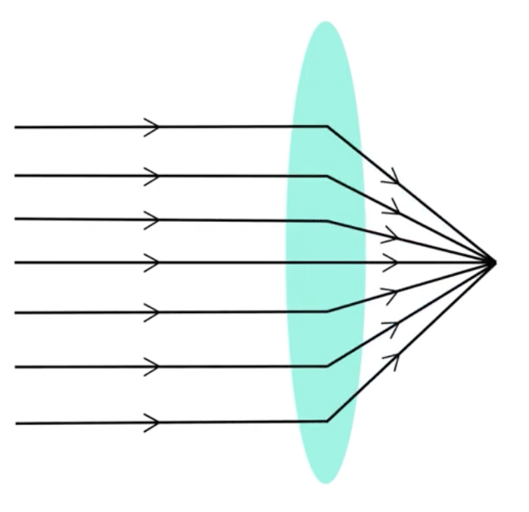
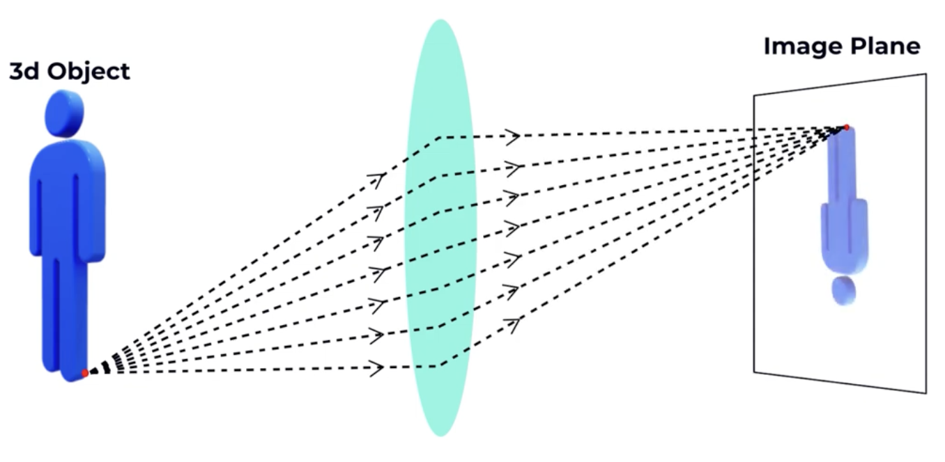
How can we get a sharp and bright image?
Lens focuses parallel light rays to impose on a single point.
Pinhole: one light ray from one point from 3D space is projected as one point on 2D image plane.
Lens: multiple parallel rays form one point projected to one point
Notes:
Then why blurry in pinhole when multiple rays enters the hole?

Slide 20
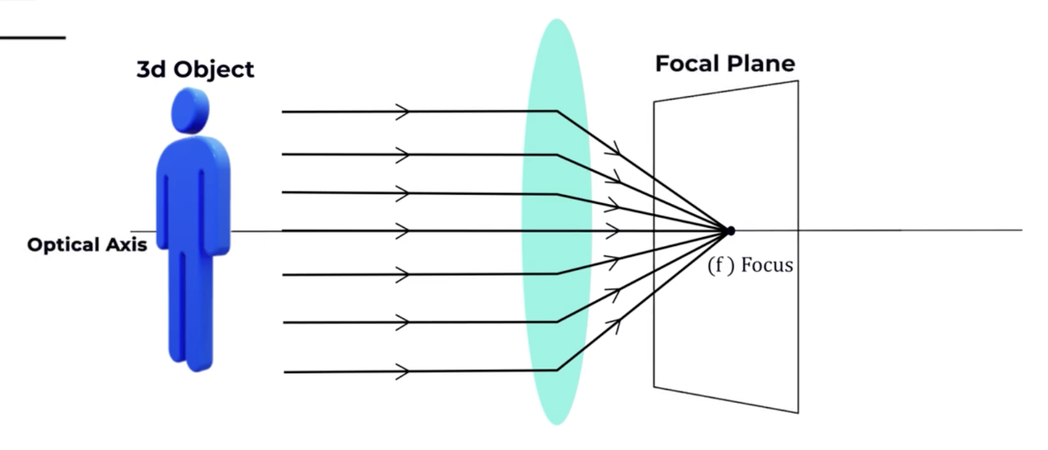
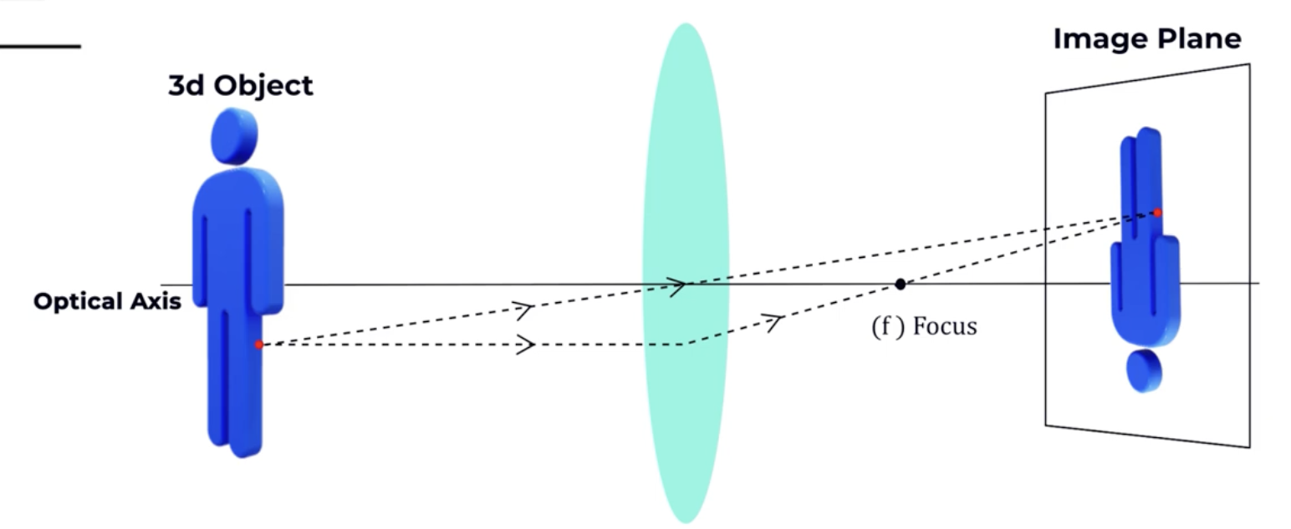
How can we get a sharp and bright image?
Multiple rays (more lights) from one point from the 3D space creates one point in the 2D space - we get a bright image and
Multiple rays are condensed on one point - we get a sharp image.
Notes:
The point where multiple rays converge to a point, we call it the focus point.
The plane containing the focus point is called the optical axis.
The plane (containing the focus point i.e., the optical axis) perpendicular to the optical axis is called the focal plane.

Slide 21
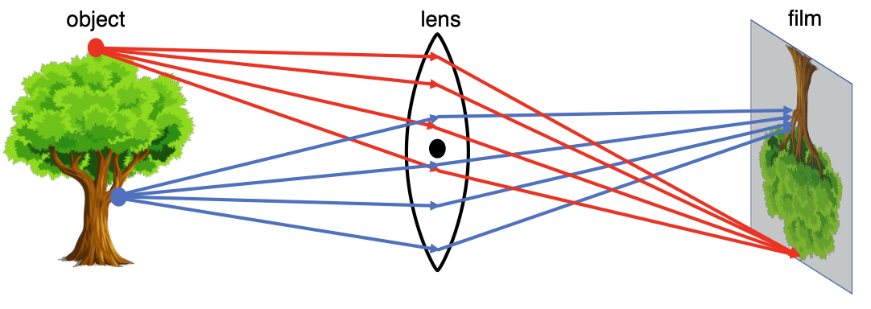

Lens camera model
All rays of light that are emitted by point $P$ are refracted by the lens such that they converge to a single point $P′$
The problem of the majority of the light rays blocked due to a small aperture is removed
Notes:
A setup of a simple lens model. Notice how the rays of the top point on the tree converge nicely on the film. However, a point at a diﬀerent distance away from the lens results in rays not converging perfectly on the film.

Slide 22

In focus and out of focus
Out of focus
In focus

Slide 23


Focus
$$P_{2}$$
$$P_{1}$$

Slide 24
Focus

Slide 25




Lens camera model
$$z$$
$$d$$
$$P \left(\begin{matrix}x \\ z\end{matrix}\right)$$
$$x^{′}=−f \frac{x}{z}$$
Notes:
that Center Ray that is going through the center is going to project to –f*x/z same old perspective projection equations
We now have to deal with the case when the point in world is closer and further how much is it going to get blurred and how can we quantify that.
We are going to now Define the
focal length of the lens to be little F
so it's no longer the lens to sensor
distance it's the focal length which has
to do with this bending property that

Slide 26




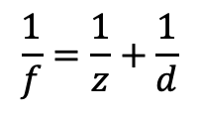
Focal length of lens
$$\frac{1}{f}=\frac{1}{z}+\frac{1}{d}$$
$$d$$
$$f$$
$$f$$
$$z$$
Notes:
that Center Ray that is going through the center is going to project to –f*x/z same old perspective projection equations
- We now have to deal with the case when the point in world is closer or further, how much is it going to get blurred? and how can we quantify that?
Focal length: take a point in world that is the same height as the height of the lens and the Ray that is going to move straight and the ray that is going to bend and where it crosses the optical axis is defined as the focal length of the lens you can do this in the opposite direction too.
- Focal length is related to the bending properties of the lens.
Now we need two things to define our camera the lens:
to sensor (image plane) distance d
the focal length f

Slide 27



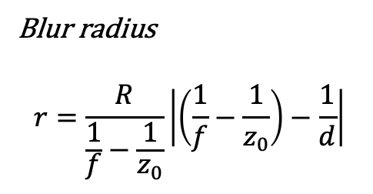
How blurry an object be, when we move the object in and out of the points those are in perfect focus?
$$z_{0}$$
$$d$$
Lens radius
$$R$$
Blur radius
$$r=\frac{R}{\frac{1}{f}−\frac{1}{z_{0}}}\left|\left(\frac{1}{f}−\frac{1}{z_{0}}\right)−\frac{1}{d}\right|$$
$$r$$
Notes:
Quick sanity check:
What happens if the radius of the lens R is zero at the limit as it approaches zero so that I have a tiny tiny little pinhole and only a single ray of light goes through wall.
let's
look at the equation the equation says
that a Big R as that approaches zero the
blur radius also approaches zero so
everything is imaged into perfect Focus
so that makes sense the amount of blur
will be proportional to how your lens or
your aperture is at the front of the
lens good that makes sense what's the
other thing that we know we know that
when Z is equal to when Z naught is
equal to Z that satisfies that thin lens
equation everything should be in perfect
Focus so let's see what happens now so
here let's look inside the absolute
value inside the absolute value is one
over F minus 1 over Z naught but if Z
naught is z satisfying the thin lens
equation that you we see here well then
that term is equal to 1 over d one over
D minus 1 over D of course is zero and
the blur radius is zero so now what we
see is that the amount of blur in the
image is proportional to two things how
big the aperture or lens is and then how
far we move in and out of this perfect
plane of focus
okay now we've got almost where we need
to be to explain a modern digital camera
that we're going to be using in our
computer vision systems and notice
something really beautiful here by the
introduction of the lens we didn't have
to throw away the perspective camera
model we didn't have to throw away
everything we have done with camera
obscurers and pinholes all we had to do
was add one extra term which is how
blurry how much smeared will content be
as a function of a certain distance from
the camera and with that we're now ready
to go on to look at some of the other
aspects of the modern digital camera

Slide 28
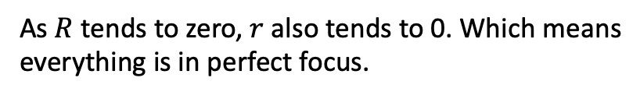

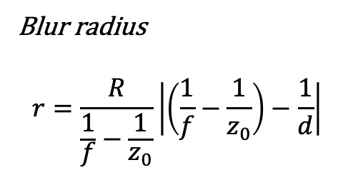

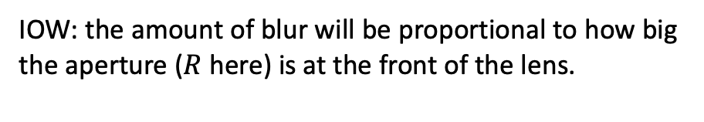
If R is zero i.e., we have a tiny tiny little pinhole and only a single ray of light goes through?
$$z_{0}$$
$$d$$
Blur radius
$$r=\frac{R}{\frac{1}{f}−\frac{1}{z_{0}}}\left|\left(\frac{1}{f}−\frac{1}{z_{0}}\right)−\frac{1}{d}\right|$$
As $R$ tends to zero, $r$ also tends to 0. Which means
everything is in perfect focus.
$$R→0$$
IOW: the amount of blur will be proportional to how big the aperture ($R$ here) is at the front of the lens.
$$r$$
Already know this from the pinhole camera model
Notes:
Quick sanity check:
What happens if the radius of the lens R is zero at the limit as it approaches zero so that I have a tiny tiny little pinhole and only a single ray of light goes through wall.
let’s look at the equation the equation says that a Big R as that approaches zero the blur radius also approaches zero so everything is imaged into perfect Focus.
The amount of blur will be proportional to how big your aperture is at the front of the lens.

Slide 29



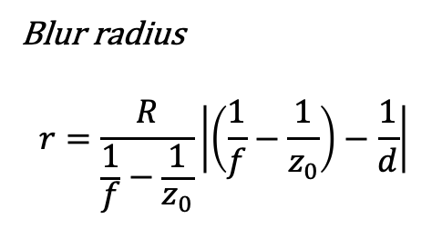
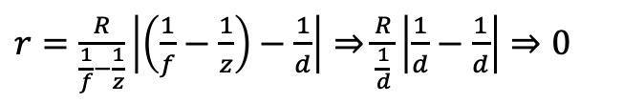



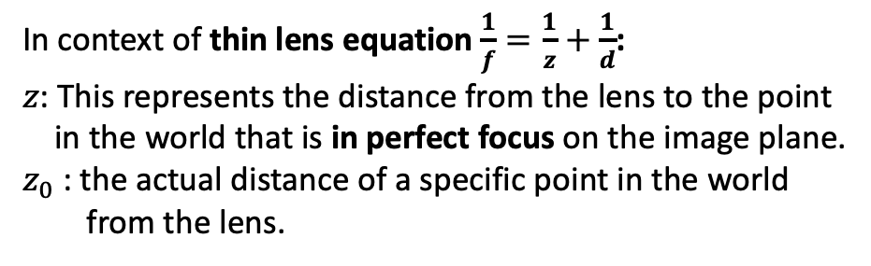
What happens when $z_{0}=z$?
In context of thin lens equation $\frac{1}{f}=\frac{1}{z}+\frac{1}{d}$:
$z$: This represents the distance from the lens to the point
in the world that is in perfect focus on the image plane.
$z_{0}$: the actual distance of a specific point in the world
from the lens.
$$z_{0}$$
$$d$$
Lens radius
If $z_{0}=z$
$\frac{1}{f}=\frac{1}{z}+\frac{1}{d}⇒\frac{1}{f}−\frac{1}{z}=\frac{1}{d}$
$$R$$
$r=\frac{R}{\frac{1}{f}−\frac{1}{z}}\left|\left(\frac{1}{f}−\frac{1}{z}\right)−\frac{1}{d}\right|⇒$ $\frac{R}{\frac{1}{d}}\left|\frac{1}{d}−\frac{1}{d}\right|⇒0$
Blur radius
$$r=\frac{R}{\frac{1}{f}−\frac{1}{z_{0}}}\left|\left(\frac{1}{f}−\frac{1}{z_{0}}\right)−\frac{1}{d}\right|$$
$$r$$
By definition, objects at distance $z$ are in
perfect focus i.e., $r$ should be 0 that checks
out from the blur radius equation
The amount of blur in the image is proportional to two things:
How big the aperture or lens is? and How far we move in and out of this perfect plane of focus?
Notes:
Quick sanity check:
variables to explain focus and blur in the context of the thin lens equation:
z: This represents the distance from the lens to the point in the world that is in perfect focus on the sensor, according to the standard thin lens equation .
z_0: This represents the actual, variable distance of a specific point in the world from the lens.
We know that when z is equal to z_0 that satisfies that thin lens equation everything should be in perfect focus.
Let's look inside the absolute value 1/f – 1/z_0. If z_0 = z then that term is equal to 1/d – 1/d which is zero and the blur radius is zero.
Now what we see that the amount of blur in the image is proportional to two things:
how big the aperture or lens is and
How far we move in and out of this perfect plane of focus

Slide 30
Readings
Image formation: lenses: thin lens:

